Slide 1
How to Make The Internet Faster
(Automatic Transition To Peer-to-Peer Download)
Notes:
When the server can’t

Slide 2
Thanks!
Family
Advisors
wE\=f P'P= \ROVIDE A U966554F545DS6TFDV87654536:01 PM 4/5/20102 098YH6Ya 1W N.I
Notes:
It isn’t just me! This is not me!

Slide 3
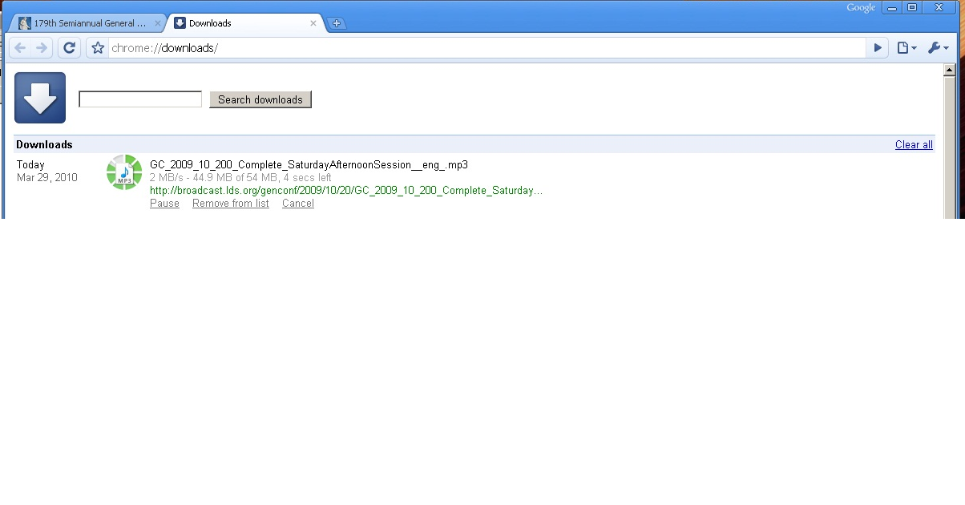
Fast download

Slide 4
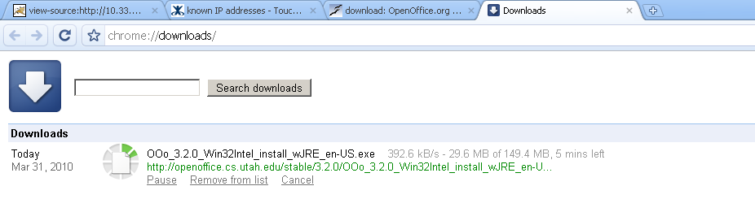
Slow downloads
Notes:
Today's Internet is slow. It is.
This is very frustrating to today's work flow, and annoying.
"today's bottleneck is no longer the disk or cpu--it's the network!"
"all this wasted bandwidth“
Add a graph of network speed increasing so slowly compared to processors [?]

Slide 5
Options
Hit reload.
Go somewhere else.
Download Manager.
Add a local proxy.
New internet connection.
Beg the server to change how they serve the file.
Notes:
Download manager—for me speeds things up, but hard to use because not integrated, also the server might run out of bandwidth.
Adding a local proxy doesn’t help if the file hasn’t been downloaded locally already—same exact problem in many cases.

Slide 6
Server options
Buy more bandwidth.
Move.
Buy more servers.
CDN
Turn to P2P.
Notes:
More servers closer to you.

Slide 7
P2P
Peers share.
Create BitTorrent File.
Host it, with tracker.
Notes:
TODO: pictures
Barrier: not just the client, but you don’t know if using the client will actually be faster. Many times it isn’t.
And some sites don’t offer P2P.
Technology is there but not easily accessible.
How many sites actually offer you that stuff?

Slide 8
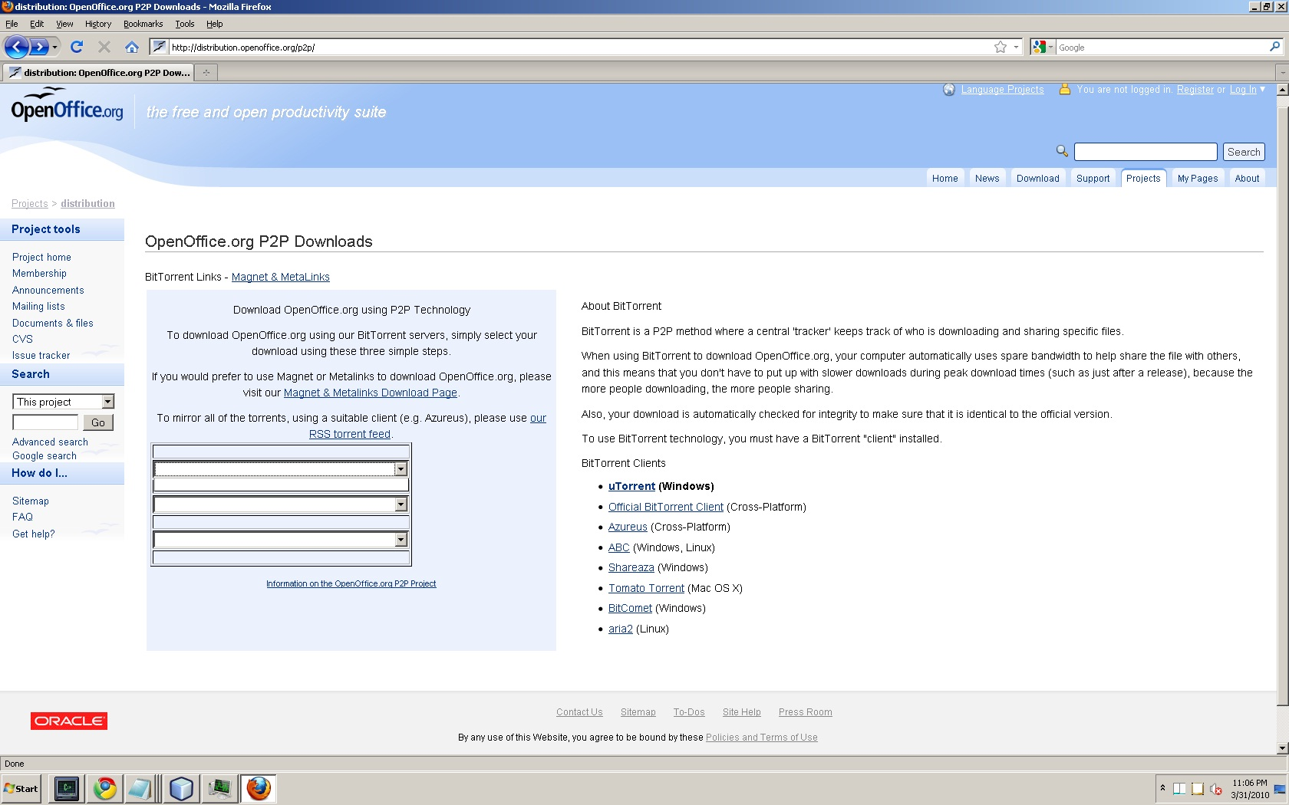
Barrier to use.
Notes:
Barrier to entry: know how to use it, choose it, and it has to be fast. Many people ignore it.
Barrier for the server too: setting it up. Barrier to client: extra cost of time to download/unreliable can cause it to cost you extra time.

